Slide 1

adaptive depth sampling
Gal Shitrit & Adam Wolff
097200 – Deep Learning Course Final Project

Slide 2
motivation

Slide 3
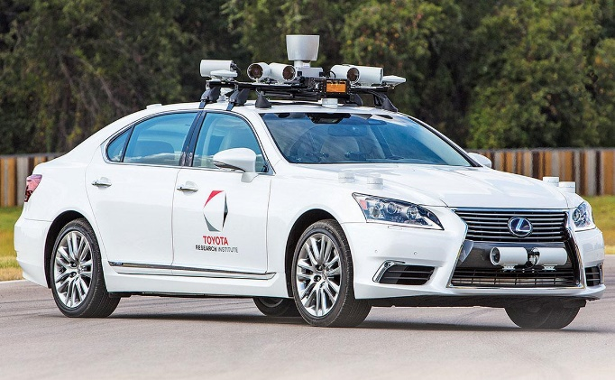
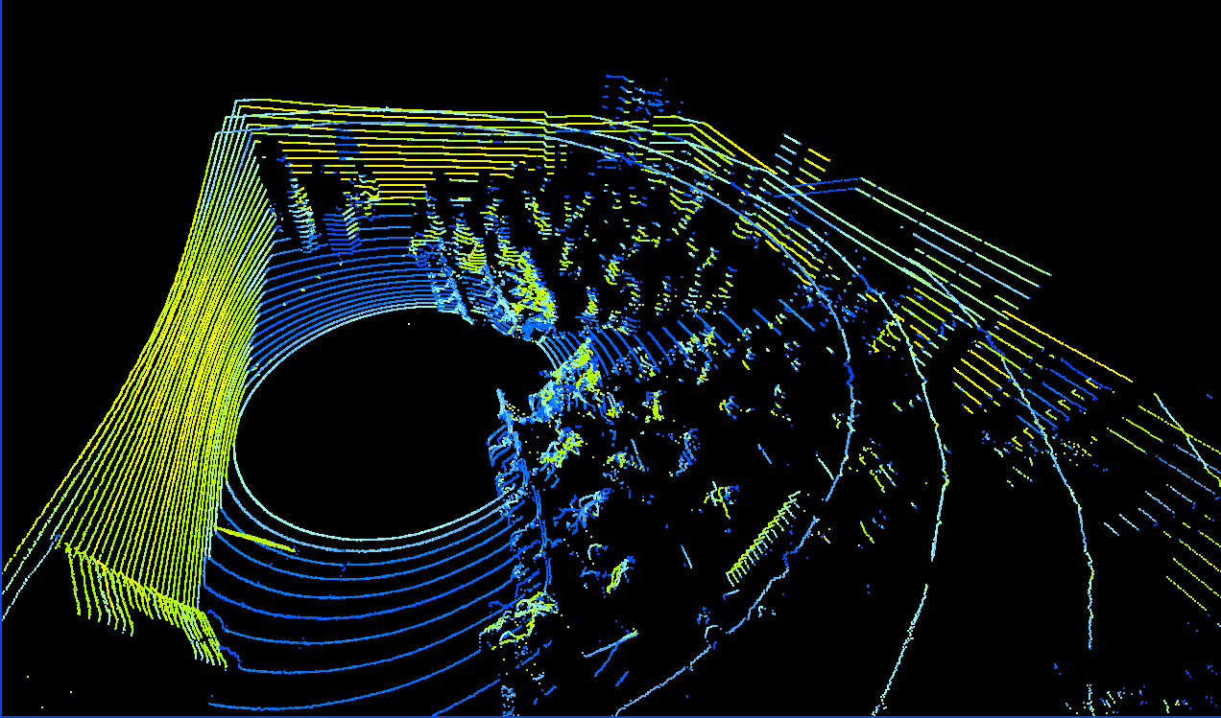
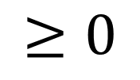
Autonomous car sensing
3D Point cloud
LiDAR
Camera
2D Sparse depth map
RGB image
$$≥0$$

Slide 4
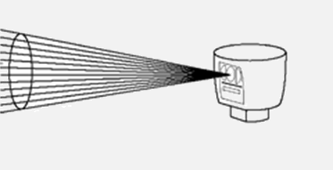
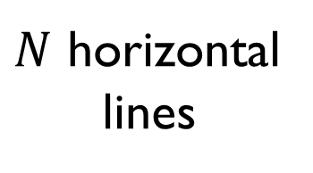
lidar
$N$ horizontal
lines
Velodyne Puck (16 lines) = 8k $
Velodyne HDL-32E (32 lines) = 30k $
Velodyne HDL-64E (64 lines) = 75k $

Slide 5
Depth completion
Depth completion
Dense depth map

Slide 6
guided depth sampling
Pattern 1
??
Pattern 2

Slide 7
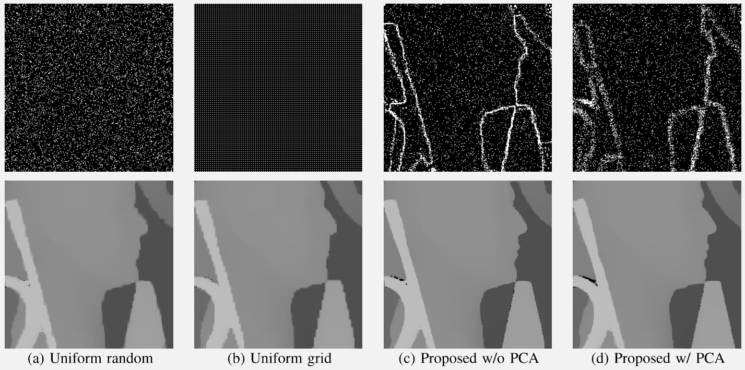
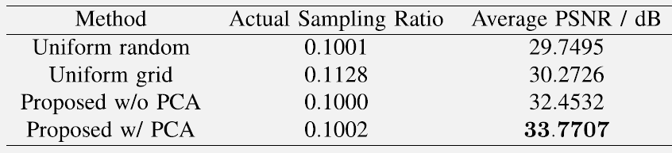
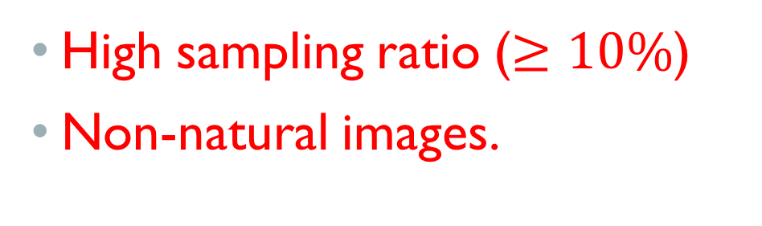
guided depth sampling
Hawe et al. (ICCV 2011)
Liu et al. (IEEE Trans. Image
Process. 2015)
High sampling ratio ($≥10\%$)
Non-natural images.

Slide 8
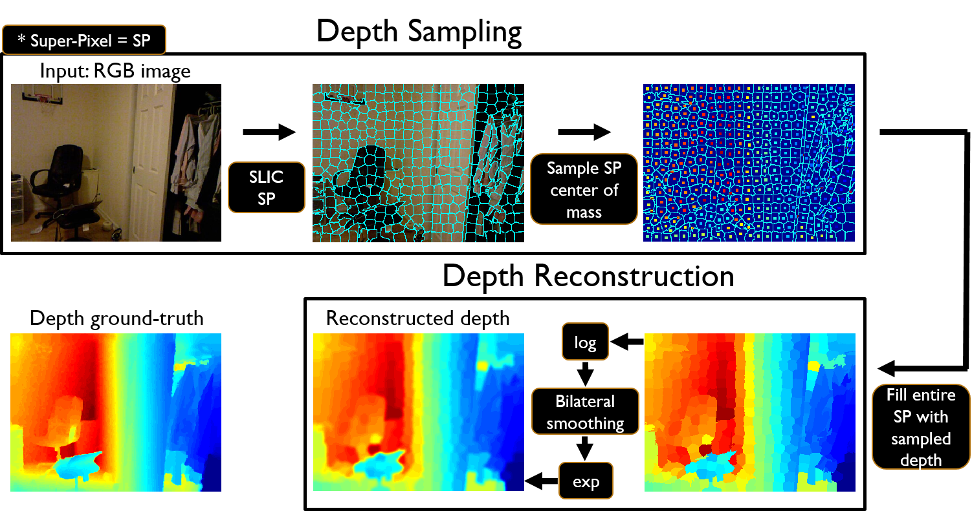
guided depth sampling
A. Wolff M.Sc thesis
No learning!!!

Slide 9
Motivation | Preliminaries | Method | Experiments | Conclusion
project goal
Designing an optimal sampling pattern for accurate depth map completion

Slide 10
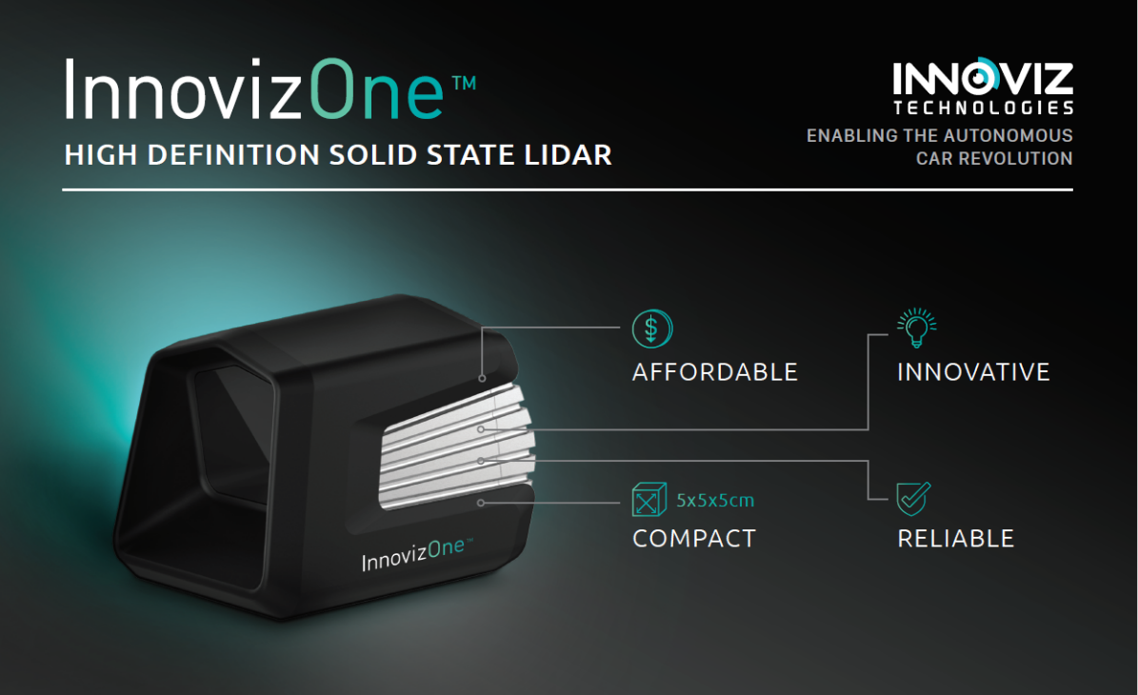
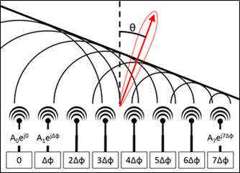
Solid-state lidar
based on optical phased-array

Slide 11
method

Slide 12
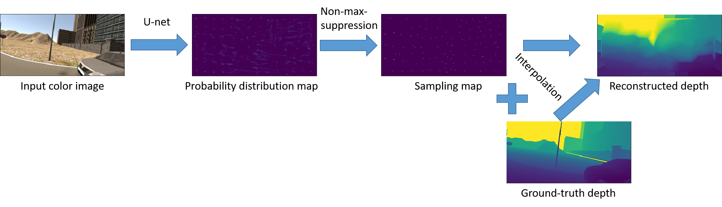
implementation
Loss
Ground-truth sampling map using super pixels (Wolff)

Slide 13

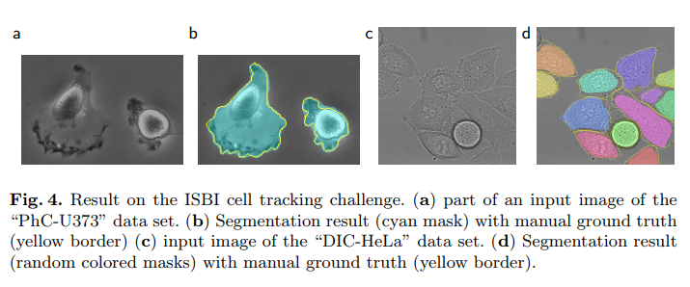
Architecture (u-net)

Slide 14
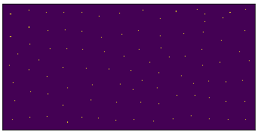
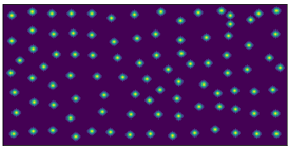
Training
Hard GT sampling probability distribution map – BCE loss
Option 1
Loss
Option 2
Gaussian filter on hard map – Soft GT sampling probability distribution map – MSE loss
Ground-truth sampling map using super pixels (Wolff)

Slide 15
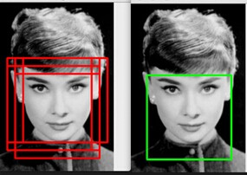
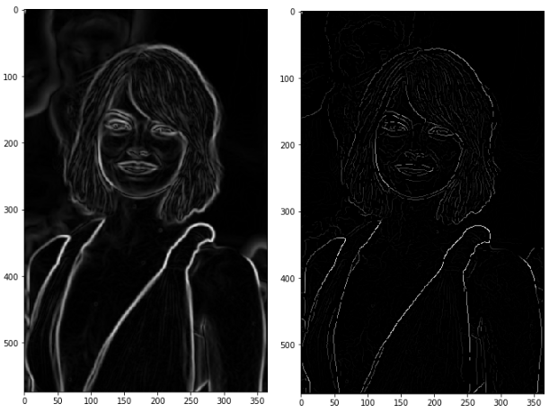
Non-max-suppression
Object detection
Canny edge detector

Slide 16
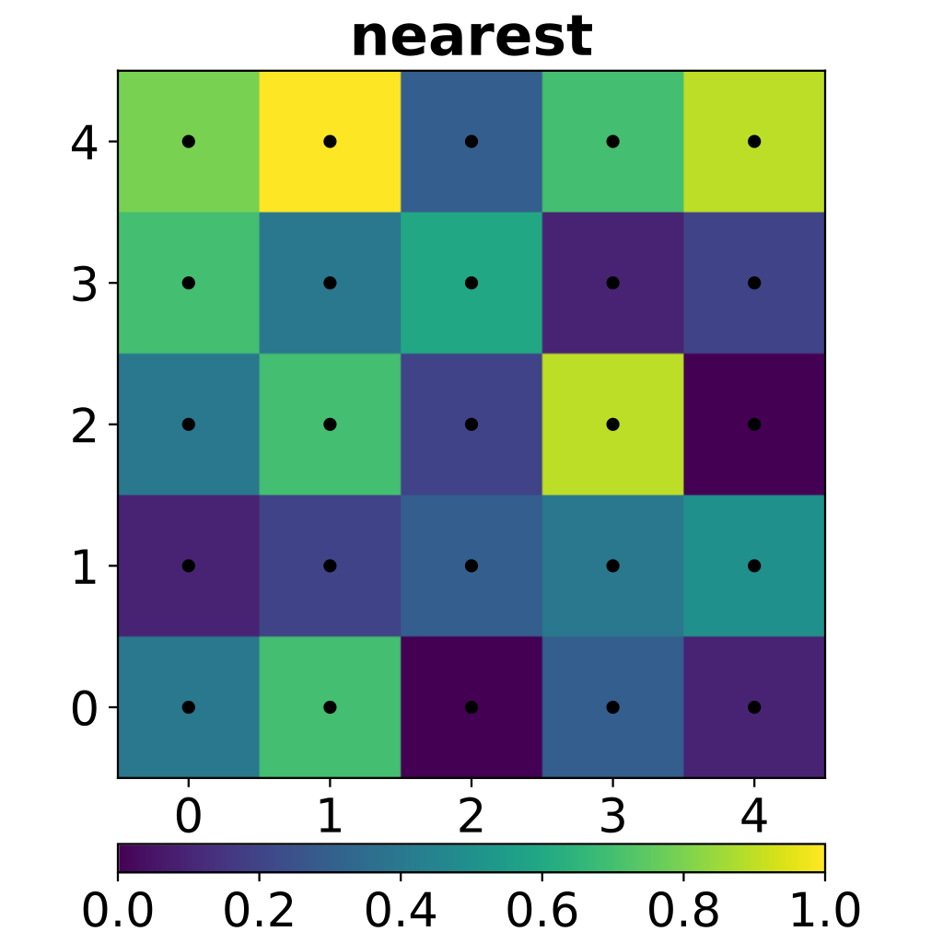
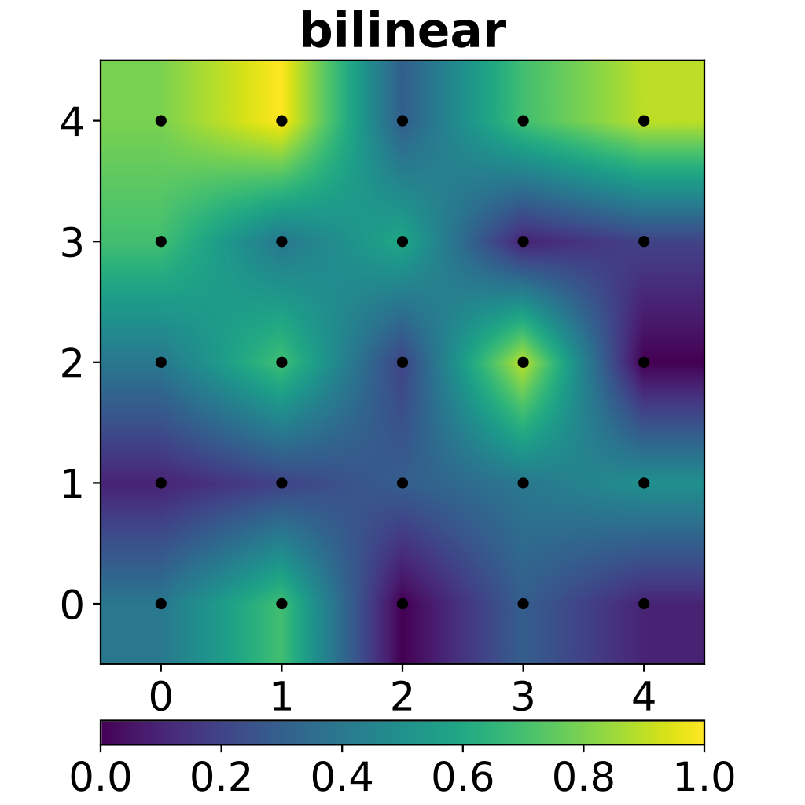
interpolation

Slide 17
Experiments

Slide 18
dataset
Synthia – synthetic urban driving scenes:
6000 images for train set, 296 images for test set

Slide 19
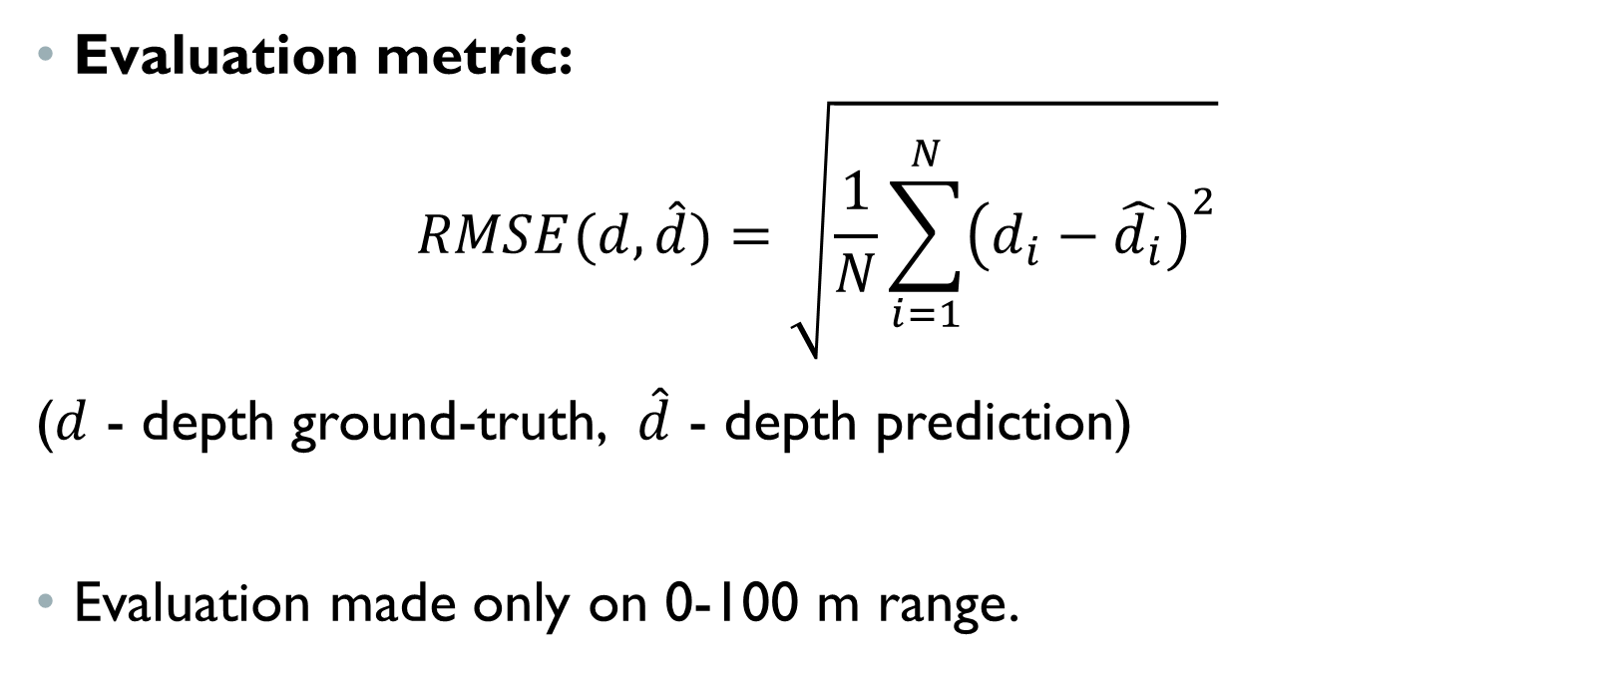
evaluation
Evaluation metric:
$$RMSE(d,\hat{d})=\sqrt{\frac{1}{N}\sum_{i=1}^{N}{{\left(d_{i}−\hat{d_{i}}\right)}^{2}}}$$
($d$ - depth ground-truth, $\hat{d}$ - depth prediction)
Evaluation made only on 0-100 m range.

Slide 20
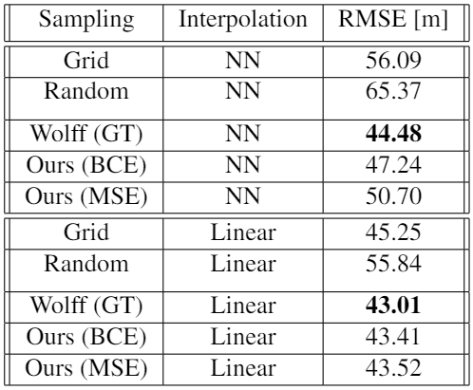
Quantitative results

Slide 21
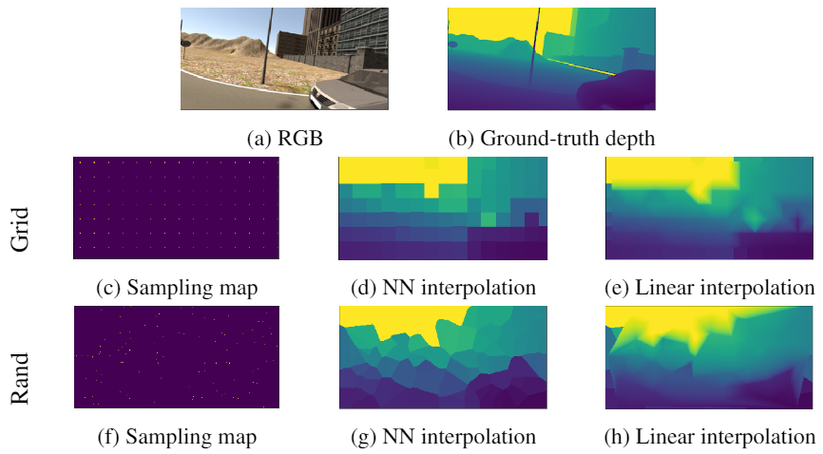
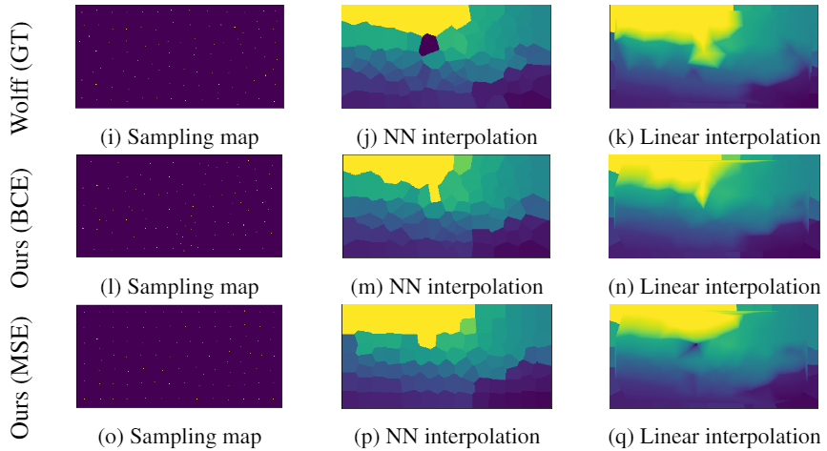
Qualitative results

Slide 22
conclusion

Slide 23
Conclusion
Adaptive sampling is worthwhile.
There is enough room to improve.
Possible future work:
Exploit temporal redundancy.
Use semantic information.
Depth completion using CNN
Produce more optimal GT sampling images using search methods such as genetic algorithms

Slide 24
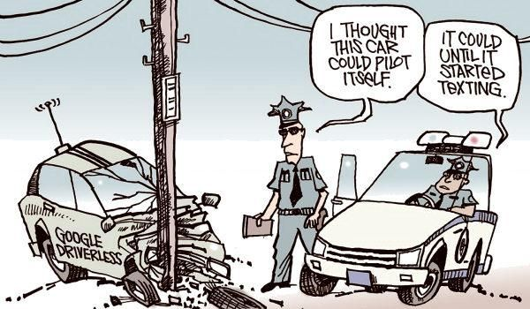
Thank you for listening!

